Slide 1
Expanding the Reach of Fuzzing From Syntax Errors to Program Synthesis
Caroline Lemieux
University of British Columbia
April 24th, 2023

Slide 2


Software Has Bugs

Slide 3
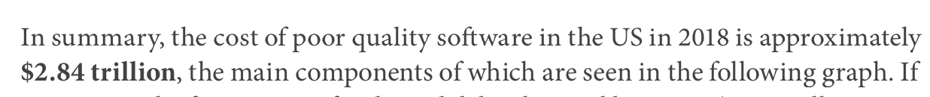








Bugs Have Increasing Consequences

Slide 4







Bugs Have Increasing Consequences
Badlock
Cloudbleed
Dirty COW
GHOST
Heartbleed
StageFright
ShellShock

Slide 5

Bugs Have Increasing Consequences
Badlock
Cloudbleed
Dirty COW
GHOST
Heartbleed
StageFright
ShellShock
the cost of
poor quality software is
$2.84 trillion
in the US in 2018

Slide 6
My Work:
build tools to help developers improve correctness, security and performance of software

Slide 7
My Work: Find Bug-Inducing Inputs
Input

Slide 8
Background on Fuzzing
My Work: Expanding the Reach of Fuzzing
Future Directions

Slide 9
Background on Fuzzing
Identify Under-Generalized Fuzzing Algorithm Components
Future Directions

Slide 10
Background on Fuzzing
Identify Under-Generalized Fuzzing Algorithm Components
Generalize/Tune to Expand Application Domains of Fuzzing
Future Directions

Slide 11
Background on Fuzzing
Future Directions

Slide 12


Background on Fuzzing
PerfFuzz
Lemieux, Padhye, Sen & Song. ISSTA ‘18
ACM/SIGSOFT Distinguished Paper Award
FuzzFactory
Padhye, Lemieux, Sen, Laurent & Vijayakumar. OOPSLA ‘19
Future Directions
Notes:
“generalize the feedback that is used to distinguish interesting inputs”

Slide 13

Background on Fuzzing
Performance Bugs
Future Directions

Slide 14
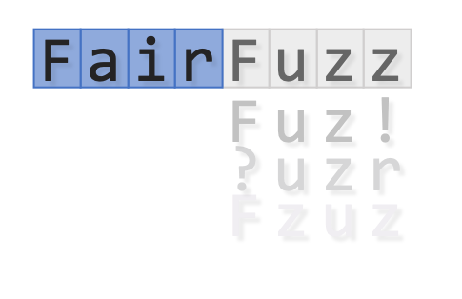

Background on Fuzzing
Performance Bugs
FairFuzz
Lemieux & Sen. ASE ‘18
ACM/SIGSOFT Distinguished Artifact Award,
Tool Demonstration Award
Zest
Padhye, Lemieux, Sen, Papadakis & Le Traon. ISSTA ‘19
Future Directions
Notes:
“bring in more structured ways of generating inputs”

Slide 15

Background on Fuzzing
Performance Bugs
Exploring Core Logic
Future Directions

Slide 16
Background on Fuzzing
Performance Bugs
Exploring Core Logic
RLCheck
Reddy, Lemieux, Padhye & Sen. ICSE ‘20.
RLCheck
AutoPandas
Bavishi, Lemieux, Sen & Stoica. OOPSLA ‘19
Future Directions
Notes:
“separate user-facing abstraction of random input generators from smart backends…”

Slide 17

Background on Fuzzing
Performance Bugs
Exploring Core Logic
Smart Generators
Future Directions

Slide 18
Background on Fuzzing
Performance Bugs
Exploring Core Logic
Smart Generators
Future Directions

Slide 19
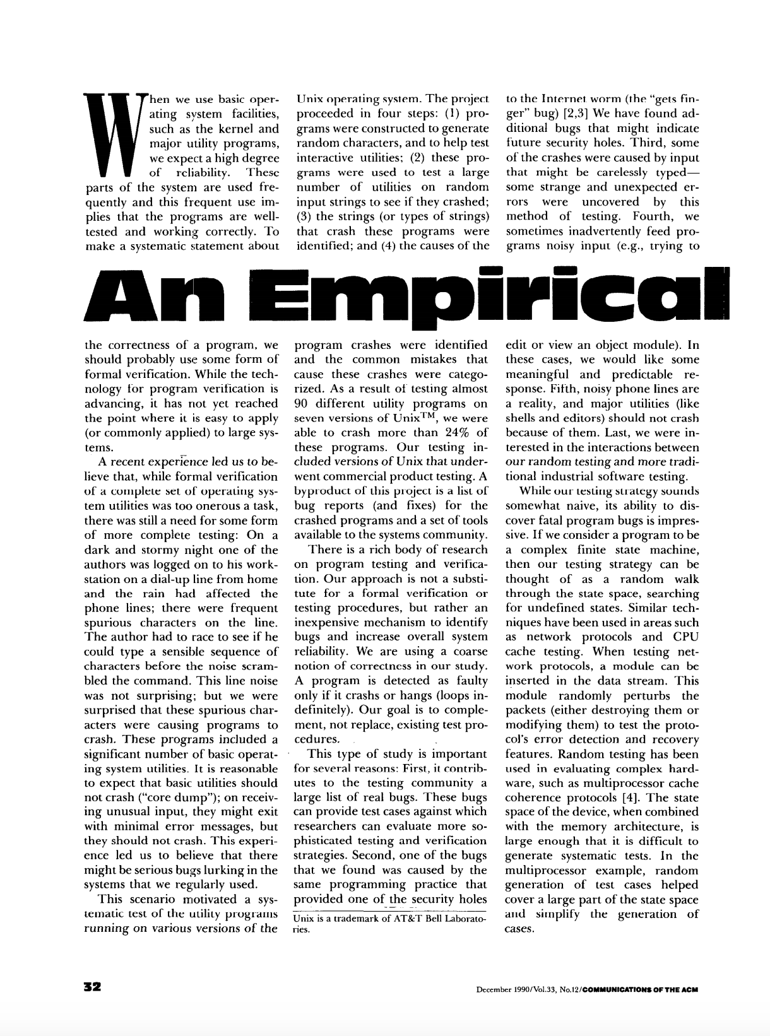

1990s: Random Fuzzing

Slide 20
1990s: Random Fuzzing
$ bc
Random Source
B. Miller, L. Fredriksen, B. So. An Empirical Study of the Reliability of Unix Utilities. Communications of the ACM, 1990.

Slide 21
1990s: Random Fuzzing
$ bc
Random Source
^[¹¨¥:õ;ãC<88>
B. Miller, L. Fredriksen, B. So. An Empirical Study of the Reliability of Unix Utilities. Communications of the ACM, 1990.

Slide 22
1990s: Random Fuzzing
$ bc
Random Source
Ö«¨..<78>àS2b
B. Miller, L. Fredriksen, B. So. An Empirical Study of the Reliability of Unix Utilities. Communications of the ACM, 1990.

Slide 23
1990s: Random Fuzzing
$ bc
Random Source
$Y&Ó<83>íyø
B. Miller, L. Fredriksen, B. So. An Empirical Study of the Reliability of Unix Utilities. Communications of the ACM, 1990.

Slide 24
1990s: Random Fuzzing
$ bc
Segmentation Fault
$
Random Source
^\®´bÖ«4^A·Þ
B. Miller, L. Fredriksen, B. So. An Empirical Study of the Reliability of Unix Utilities. Communications of the ACM, 1990.

Slide 25
1990s: Random Fuzzing
$ bc
Segmentation Fault
$
Random Source
^\®´bÖ«4^A·Þ
B. Miller, L. Fredriksen, B. So. An Empirical Study of the Reliability of Unix Utilities. Communications of the ACM, 1990.

Slide 26
1990s: Random Fuzzing
fuzz
Input
program under test
B. Miller, L. Fredriksen, B. So. An Empirical Study of the Reliability of Unix Utilities. Communications of the ACM, 1990.
Notes:
“fuzz” was this program that generated

Slide 27
Modern Fuzzing

Slide 28
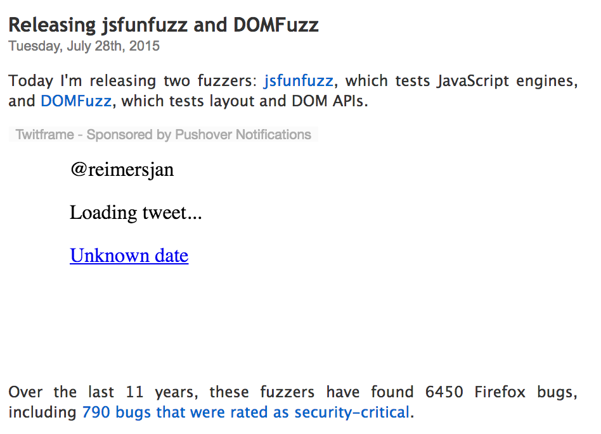



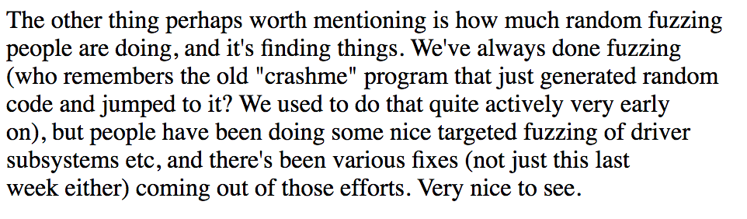
Modern Fuzzing
Notes:
Today I’ll be talking to you about modern fuzzing algorithms

Slide 29
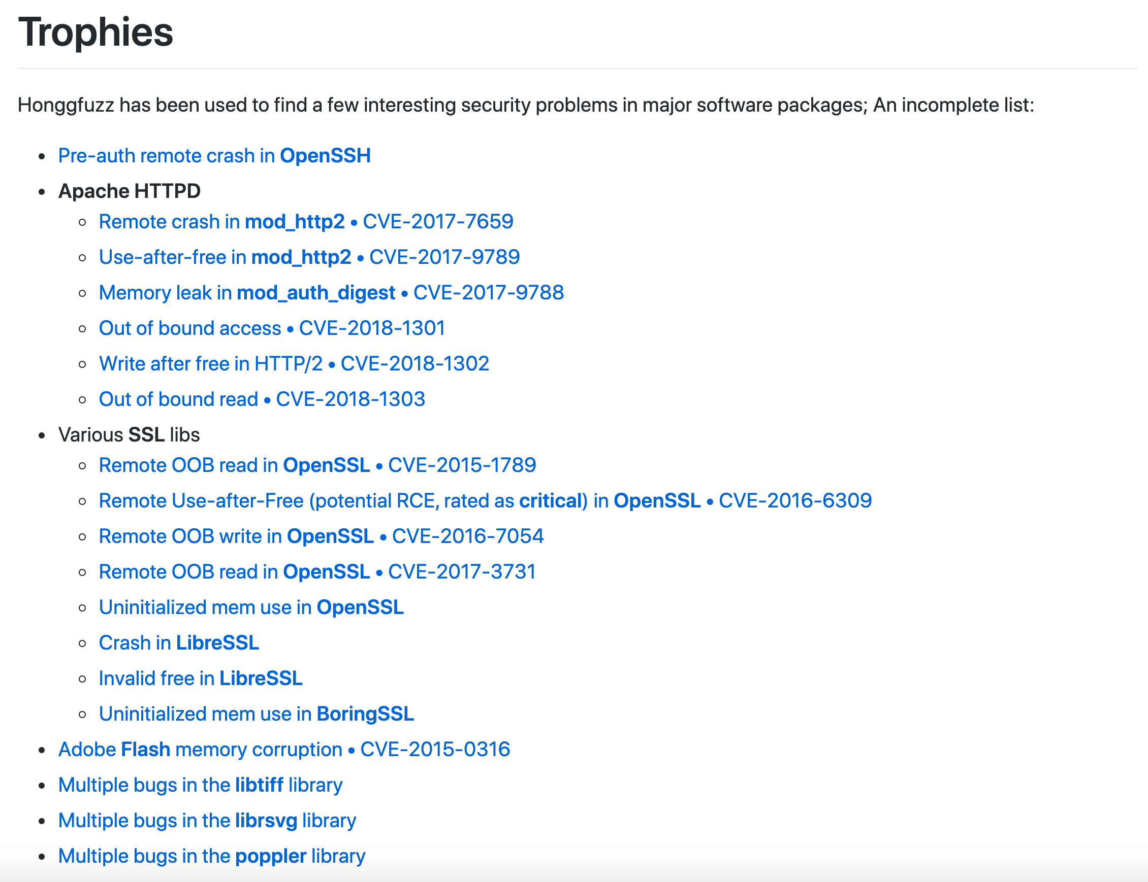
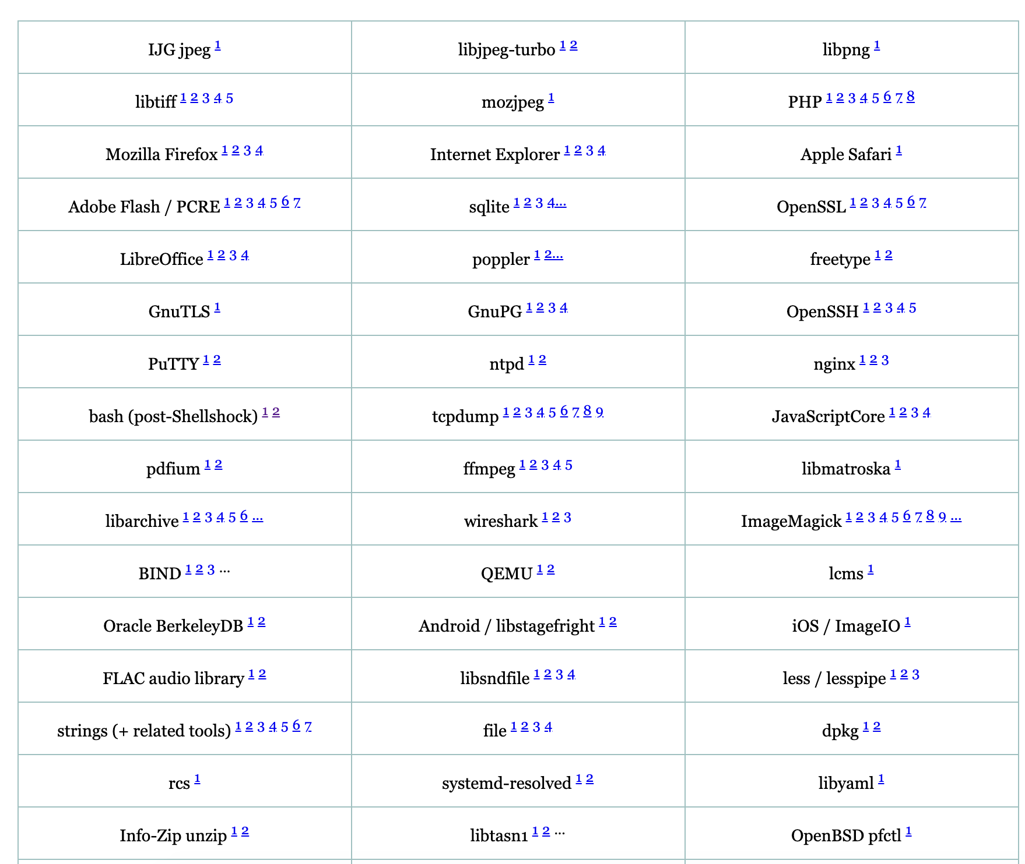
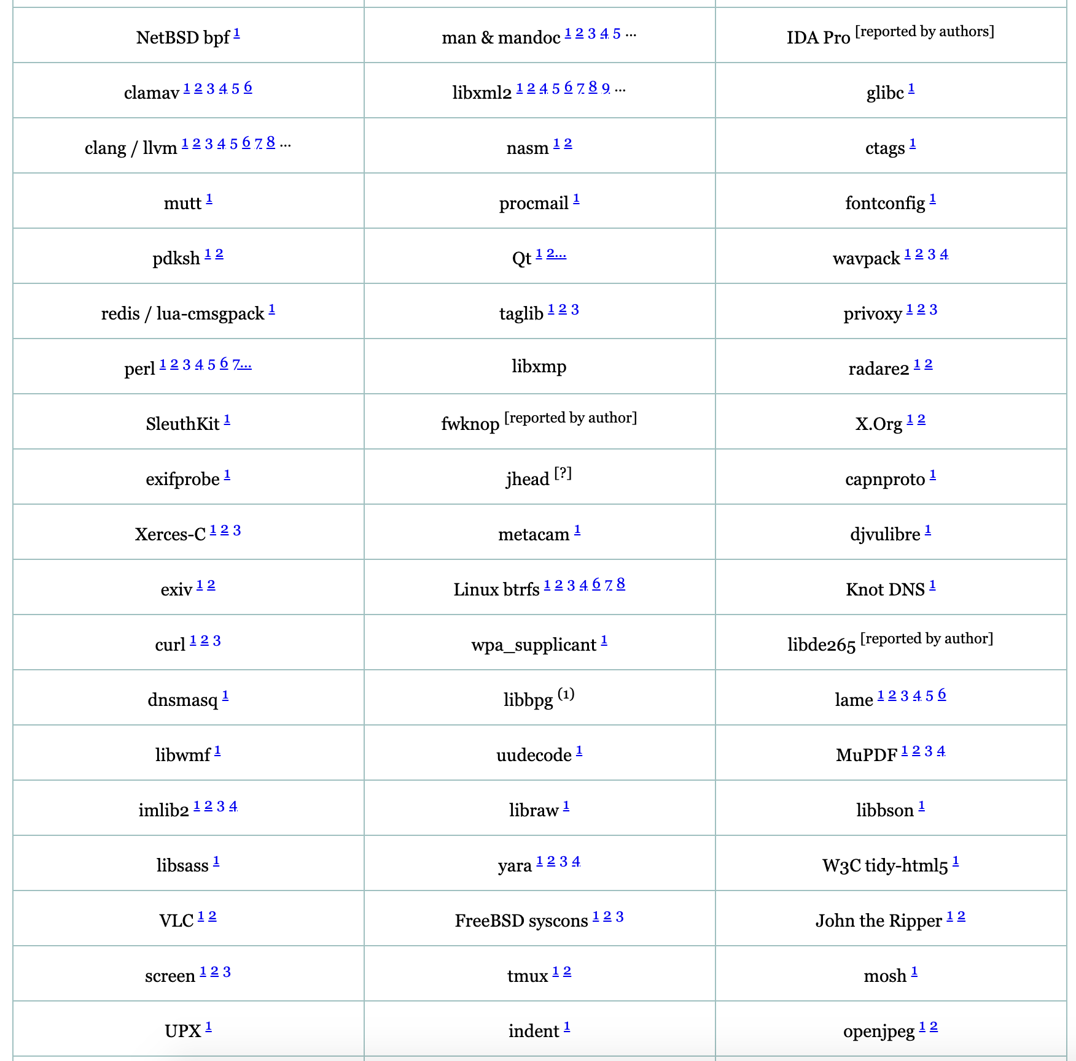
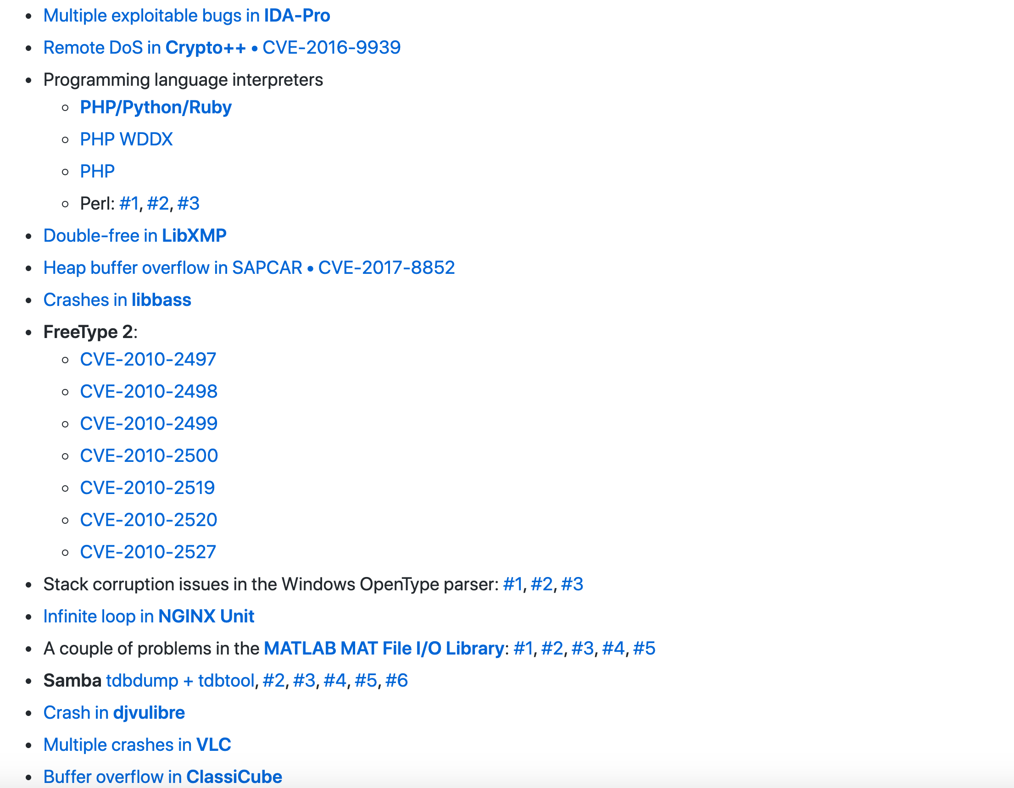
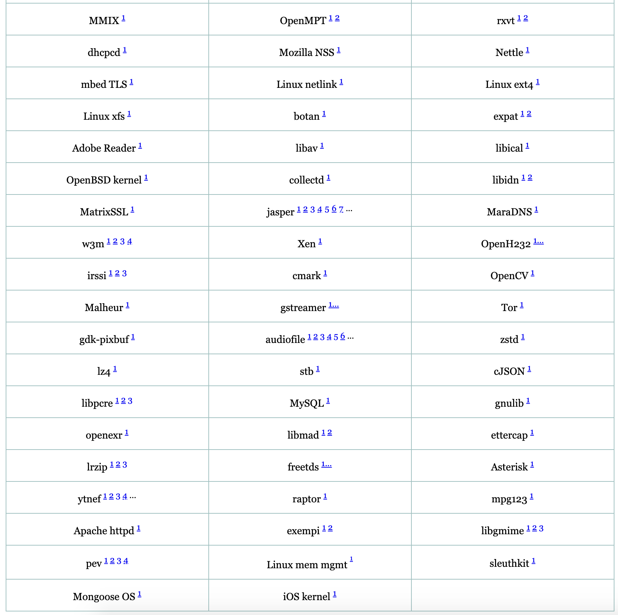
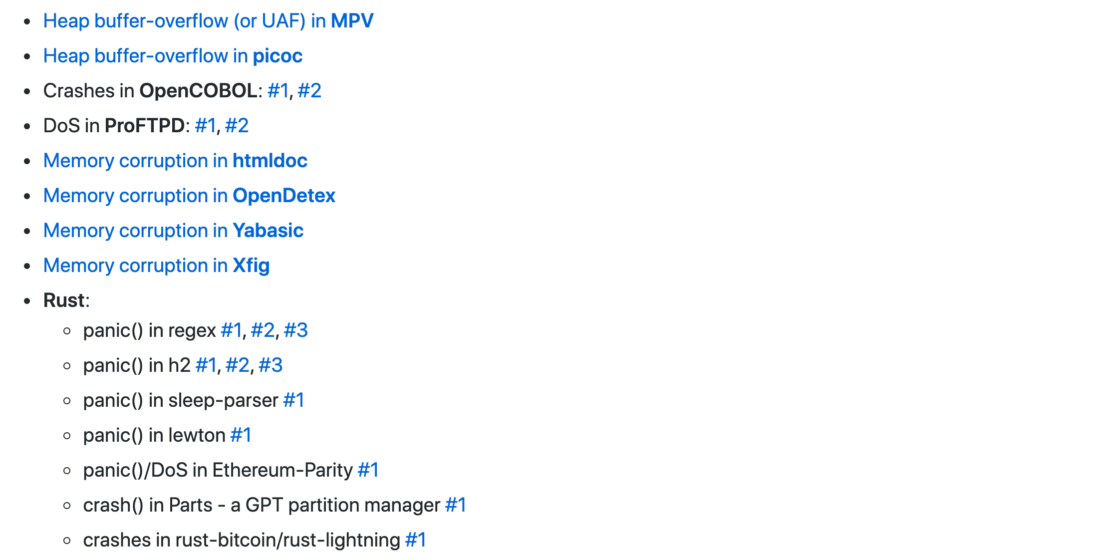
Modern Fuzzing

Slide 30
OpenSSL Case Study
Before Adoption of Modern Fuzzing
Heartbleed
Severity: 7.5 HIGH
Introduced: 14 Mar 2012
Discovered: 1 Apr 2014
Fixed: 7 Apr 2014
“... can be used to reveal up to 64k of memory to a connected client or server ...”
Costs:
>$500 million
30,000 X.509 certificates compromised
4.5 million patient records compromised
CRA website shutdown, 900 SINs leaked
…

Slide 31
OpenSSL Case Study
Before Adoption of Modern Fuzzing
Heartbleed
Severity: 7.5 HIGH
Introduced: 14 Mar 2012
Discovered: 1 Apr 2014
Fixed: 7 Apr 2014
“... can be used to reveal up to 64k of memory to a connected client or server ...”
Costs:
>$500 million
30,000 X.509 certificates compromised
4.5 million patient records compromised
CRA website shutdown, 900 SINs leaked
…

Slide 32
OpenSSL Case Study
Before Adoption of Modern Fuzzing
Heartbleed
Severity: 7.5 HIGH
Introduced: 14 Mar 2012
Discovered: 1 Apr 2014
Fixed: 7 Apr 2014
“... can be used to reveal up to 64k of memory to a connected client or server ...”
Costs:
>$500 million
30,000 X.509 certificates compromised
4.5 million patient records compromised
CRA website shutdown, 900 SINs leaked
…

Slide 33
OpenSSL Case Study
Before Adoption of Modern Fuzzing
After Adoption of Modern Fuzzing
?
Heartbleed
Severity: 7.5 HIGH
Introduced: 14 Mar 2012
Discovered: 1 Apr 2014
Fixed: 7 Apr 2014
CVE-2016-6309
Severity: 9.8 CRITICAL
Introduced: 22 Sep 2016
Discovered: 23 Sep 2016
Fixed: 26 Sep 2016
“... can be used to reveal up to 64k of memory to a connected client or server ...”
“... likely to result in a crash, however it could potentially lead to execution of arbitrary code ...”
Costs:
>$500 million
30,000 X.509 certificates compromised
4.5 million patient records compromised
CRA website shutdown, 900 SINs leaked
…
Costs:
minimal

Slide 34
OpenSSL Case Study
Before Adoption of Modern Fuzzing
After Adoption of Modern Fuzzing
?
Heartbleed
Severity: 7.5 HIGH
Introduced: 14 Mar 2012
Discovered: 1 Apr 2014
Fixed: 7 Apr 2014
CVE-2016-6309
Severity: 9.8 CRITICAL
Introduced: 22 Sep 2016
Discovered: 23 Sep 2016
Fixed: 26 Sep 2016
by honggfuzz
(modern coverage-guided fuzzer)
“... can be used to reveal up to 64k of memory to a connected client or server ...”
“... likely to result in a crash, however it could potentially lead to execution of arbitrary code ...”
Costs:
>$500 million
30,000 X.509 certificates compromised
4.5 million patient records compromised
CRA website shutdown, 900 SINs leaked
…
Costs:
minimal

Slide 35
Coverage-Guided Fuzzing
AFL, libFuzzer, honggfuzz
Input
Input
Initial
Input
Input
Input
pick
mutate
Input
execute
Input
Input
Input_{n}’
save
Execution Feedback
Execution Feedback
Input₂’
Interesting Feedback?
Execution Feedback
Input_{n}’
Execution Feedback_{n}
Notes:
Instead of generating inputs totally randomly, these modern coverage-guided fuzzers generate them via a genetic-algorithm-like loop

Slide 36
Coverage-Guided Fuzzing
AFL, libFuzzer, honggfuzz
Input
Input
Initial
Input
Input
Input
pick
mutate
Input
execute
<a>b</a>
Input
Input_{n}’
save
Execution Feedback
Execution Feedback
Input₂’
Interesting Feedback?
Execution Feedback
Input_{n}’
Execution Feedback_{n}

Slide 37
Coverage-Guided Fuzzing
AFL, libFuzzer, honggfuzz
Input
Input
Initial
Input
Input
Input
pick
mutate
Input
execute
<a>b</a>
<a>b</a>
<aa>b</a>
save
Execution Feedback
Execution Feedback
Input₂’
Interesting Feedback?
Execution Feedback
Input_{n}’
Execution Feedback_{n}

Slide 38
Coverage-Guided Fuzzing
AFL, libFuzzer, honggfuzz
Input
Input
Initial
Input
Input
Input
pick
mutate
Input
execute
$ xmllint
<a>b</a>
<a>b</a>
<aa>b</a>
save
Execution Feedback
Execution Feedback
Input₂’
Interesting Feedback?
Execution Feedback
Input_{n}’
Execution Feedback

Slide 39
Coverage-Guided Fuzzing
AFL, libFuzzer, honggfuzz
Input
Input
Initial
Input
Input
Input
pick
mutate
Input
execute
$ xmllint
<a>b</a>
<a>b</a>
<aa>b</a>
tags_match(input)
save
T
F
Bracjes Cpvered
Bracjes Cpvered
tag == “a”
...
Input₂’
Interesting Feedback?
Bracjes Cpvered
Input_{n}’
Branches Covered
T
F
...
tag == “b”

Slide 40
Coverage-Guided Fuzzing
AFL, libFuzzer, honggfuzz
Input
Input
Initial
Input
Input
Input
pick
mutate
Input
execute
$ xmllint
<a>b</a>
<a>b</a>
<aa>b</a>
tags_match(input)
save
T
F
Bracjes Cpvered
Bracjes Cpvered
tag == “a”
...
Input₂’
Interesting Feedback?
Bracjes Cpvered
Input_{n}’
tags_match(input)
F
T
F
is_recoverable(err)
T
...
...
tag == “b”

Slide 41
Coverage-Guided Fuzzing
AFL, libFuzzer, honggfuzz
Input
Input
Initial
Input
Input
Input
pick
mutate
Input
execute
$ xmllint
<a>b</a>
<a>b</a>
<aa>b</a>
tags_match(input)
save
T
F
Bracjes Cpvered
Bracjes Cpvered
tag == “a”
...
<aa>b</a>
New Branch Covered?
Bracjes Cpvered
<aa>b</a>
tags_match(input)
F
T
F
is_recoverable(err)
T
...
...
tag == “b”

Slide 42
Coverage-Guided Fuzzing
AFL, libFuzzer, honggfuzz
<aa>b</a>
<aa>b</a>
Input
Input
Initial
Input
Input
Input
pick
mutate
Input
execute
$ xmllint
<a>b</a>
<a>b</a>
<aa>b</a>
tags_match(input)
save
T
F
Bracjes Cpvered
Bracjes Cpvered
tag == “a”
...
<aa>b</a>
New Branch Covered?
Bracjes Cpvered
<aa>b</a>
tags_match(input)
F
T
F
is_recoverable(err)
T
...
...
tag == “b”

Slide 43
Coverage-Guided Fuzzing
Input
Input
Initial
Input
Input
Input
pick
mutate
Input
execute
Input
Input
Input_{n}’
save
Execution Feedback
Execution Feedback
Input₂’
Interesting Feedback?
Execution Feedback
Input_{n}’
Execution Feedback_{n}

Slide 44
dModern Fuzzingd
Coverage-Guided Fuzzing
Input
Input
Input
Input
Input
pick
mutate
Input
execute
Input
Input
Input_{n}’
save
Execution Feedback
Execution Feedback
Input₂’
Interesting Feedback?
Execution Feedback
Input_{n}’
Execution Feedback_{n}
Examples: AFLFast, Vuzzer, Angora, REDQUEEN, Steelix, AFLGo, MOpt-AFL, Entropic,…

Slide 45
dModern Fuzzingd
Coverage-Guided Fuzzing
Generator-Based Fuzzing
Input
Input
Input
Input
Input
pick
mutate
Input
execute
Input
Input
Input_{n}’
Input Generator
Input
save
Execution Feedback
Execution Feedback
Input₂’
Interesting Feedback?
Execution Feedback
Input_{n}’
Execution Feedback_{n}

Slide 46
Generator-Based Fuzzing
Input Generator
Input
Notes:
Except we have this more complex input generator that returns inputs in some search space

Slide 47
Generator-Based Fuzzing
$ xmllint
Input Generator
Input

Slide 48
Generator-Based Fuzzing
def genXML(random):
tag = random.choice(tags)
node = XMLElement(tag)
num_child = random.nextInt(0, MAX_CHILDREN)
for i in range(0, num_child):
node.addChild(genXML(random))
if random.nextBoolean():
node.addText(random.nextString()) return node
$ xmllint

Slide 49
Generator-Based Fuzzing
def genXML(random):
tag = random.choice(tags)
node = XMLElement(tag)
num_child = random.nextInt(0, MAX_CHILDREN)
for i in range(0, num_child):
node.addChild(genXML(random))
if random.nextBoolean():
node.addText(random.nextString()) return node
$ xmllint
<a>bb</a>

Slide 50
Generator-Based Fuzzing
def genXML(random):
tag = random.choice(tags)
node = XMLElement(tag)
num_child = random.nextInt(0, MAX_CHILDREN)
for i in range(0, num_child):
node.addChild(genXML(random))
if random.nextBoolean():
node.addText(random.nextString()) return node
$ xmllint
<go>x</go>

Slide 51
Generator-Based Fuzzing
def genXML(random):
tag = random.choice(tags)
node = XMLElement(tag)
num_child = random.nextInt(0, MAX_CHILDREN)
for i in range(0, num_child):
node.addChild(genXML(random))
if random.nextBoolean():
node.addText(random.nextString()) return node
$ xmllint
<a><b></b></a>

Slide 52
Generator-Based Fuzzing
def genXML(random):
tag = random.choice(tags)
node = XMLElement(tag)
num_child = random.nextInt(0, MAX_CHILDREN)
for i in range(0, num_child):
node.addChild(genXML(random))
if random.nextBoolean():
node.addText(random.nextString()) return node
$ xmllint
<bar>f</bar>

Slide 53
Generator-Based Fuzzing
def genXML(random):
tag = random.choice(tags)
node = XMLElement(tag)
num_child = random.nextInt(0, MAX_CHILDREN)
for i in range(0, num_child):
node.addChild(genXML(random))
if random.nextBoolean():
node.addText(random.nextString()) return node
$ xmllint
<go><b></b><x>spm</x></go>

Slide 54
Generator-Based Fuzzing
Input Generator
Input
written by developer conducting testing
(or reuse a suitable one)

Slide 55
dModern Fuzzingd
Coverage-Guided Fuzzing
Generator-Based Fuzzing
Input
Input
Input
Input
Input
pick
mutate
Input
execute
Input
Input
Input_{n}’
Input Generator
Input
save
Execution Feedback
Execution Feedback
Input₂’
Interesting Feedback?
Execution Feedback
Input_{n}’
Execution Feedback_{n}
Examples: QuickCheck, PEACH, Hypothesis, beStorm, boofuzz, CSmith, jsfunfuzz, DOMFuzz, …

Slide 56
dModern Fuzzingd
Coverage-Guided Fuzzing
Generator-Based Fuzzing
Drawback: malformed inputs
Drawback: user effort to make effective
Input
Input
Input
Exploring Core Logic
Input
Input
Input
pick
Input
mutate
Input
execute
Input_{n}’
Smart Generators
Input Generator
Input
save
Execution Feedback
Execution Feedback
Input₂’
Interesting Feedback?
Execution Feedback
Input_{n}’
Execution Feedback_{n}
Drawback: fixed testing goal (coverage)
Performance Bugs

Slide 57
Background on Fuzzing
Performance Bugs
Exploring Core Logic
Smart Generators
Future Directions

Slide 58
Background on Fuzzing
Performance Bugs
Exploring Core Logic
Smart Generators
Future Directions

Slide 59
Background on Fuzzing
PerfFuzz
Lemieux, Padhye, Sen & Song. ISSTA ‘18
ACM/SIGSOFT Distinguished Paper Award
FuzzFactory
Padhye, Lemieux, Sen, Laurent & Vijayakumar. OOPSLA ‘19
Exploring Core Logic
Smart Generators
Future Directions

Slide 60
Performance Bugs
Notes:
Performance problems often appear unexpectedly when a program is provided with inputs that exhibit worst-case or pathological behavior

Slide 61
Performance Bugs
Notes:
Performance problems often appear unexpectedly when a program is provided with inputs that exhibit worst-case or pathological behavior

Slide 62

Performance Bugs
Takes 1+ minute to report syntax error:
Notes:
Performance problems often appear unexpectedly when a program is provided with inputs that exhibit worst-case or pathological behavior

Slide 63
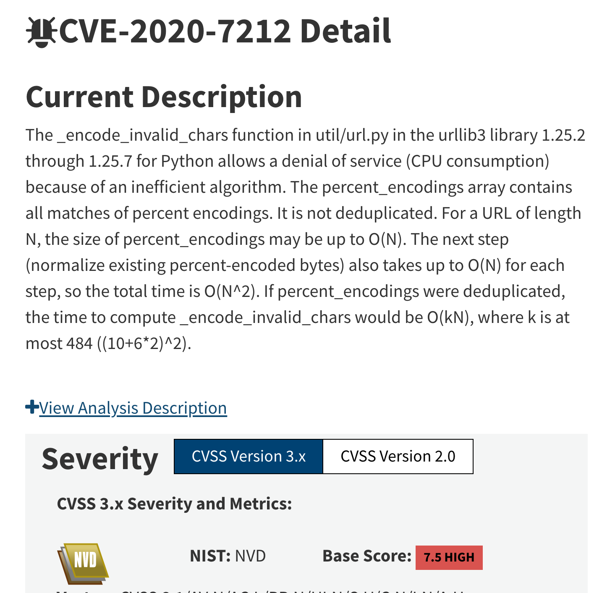

Performance Bugs
Takes 1+ minute to report syntax error:
Notes:
Performance problems often appear unexpectedly when a program is provided with inputs that exhibit worst-case or pathological behavior

Slide 64
Fuzzing to Find Performance Bugs

Slide 65
Fuzzing to Find Performance Bugs
Input
Input
Initial
Input
Input
Input
pick
mutate
Input
execute
Input
Input
Input_{n}’
save
Execution Feedback
Execution Feedback
Input₂’
Interesting Feedback?
Execution Feedback
Input_{n}’
Execution Feedback_{n}
Input executes for longer?
Execution time of input

Slide 66
Fuzzing to Find Performance Bugs
Input
Input
Initial
Input
✗
Input
Input
pick
mutate
Input
execute
Input
Input
Input_{n}’
Single-objective fuzzing
→ Gets stuck in local maxima
save
Execution Feedback
Execution Feedback
Input₂’
Interesting Feedback?
Execution Feedback
Input_{n}’
Execution Feedback_{n}
Input executes for longer?
Execution time of input

Slide 67
Example Program: Word Frequency (wf)
Count frequency of words in string
input:
the quick brown the dog
output:
brown: 1
dog: 1
quick: 1
the: 2
Notes:
Now, let’s look at how the execution counts of CFG edges vary for inputs with different performance behavior.
To introduce the PerfFuzz technique, I’m going to walk through how it works for this example program: word frequency. This word frequency program should ouput the number of times each word appears in the given input string; so in
To introduce PerfFuzz, I’ll focus on applying it to a particular program. A simple way to implement such a program is with a hash table, and a simple way to implement a hash table

Slide 68
Example Program: Word Frequency (wf)
for word in words
Count frequency of words in string
id = hash(word)
entry = table[id]
input:
the quick brown the dog
F
while entry != None
output:
brown: 1
dog: 1
quick: 1
the: 2
T
if entry.word == word
F
T
entry = entry.next
entry.count += 1
break
table[id] = new entry(word=word,
count=1, next=table[id])
Notes:
Now, let’s look at how the execution counts of CFG edges vary for inputs with different performance behavior.
To introduce the PerfFuzz technique, I’m going to walk through how it works for this example program: word frequency. This word frequency program should ouput the number of times each word appears in the given input string; so in
To introduce PerfFuzz, I’ll focus on applying it to a particular program. A simple way to implement such a program is with a hash table, and a simple way to implement a hash table

Slide 69
wf Performance Response
Edge | # Hits
A
B
C
D
for word in words
Usual case:
the quick brown the dog
id = hash(word)
entry = table[id]
A
F
while entry != None
T
B
if entry.word == word
F
C
D
T
entry = entry.next
entry.count += 1
break
table[id] = new entry(word=word,
count=1, next=table[id])

Slide 70
wf Performance Response
Edge | # Hits
A | 4
B
C
D
for word in words
Usual case:
the quick brown the dog
id = hash(word)
entry = table[id]
4
A
F
while entry != None
T
B
if entry.word == word
F
C
D
T
entry = entry.next
entry.count += 1
break
table[id] = new entry(word=word,
count=1, next=table[id])

Slide 71
wf Performance Response
Edge | # Hits
A | 4
B | 1
C
D
for word in words
Usual case:
the quick brown the dog
id = hash(word)
entry = table[id]
4
A
F
while entry != None
T
B
1
if entry.word == word
F
C
D
T
entry = entry.next
entry.count += 1
break
table[id] = new entry(word=word,
count=1, next=table[id])

Slide 72
wf Performance Response
Edge | # Hits
A | 4
B | 1
C | 0
D | 1
for word in words
Usual case:
the quick brown the dog
id = hash(word)
entry = table[id]
4
A
F
while entry != None
T
B
1
if entry.word == word
C
0
D
1
F
T
entry = entry.next
entry.count += 1
break
table[id] = new entry(word=word,
count=1, next=table[id])

Slide 73
wf Performance Response
Edge | # Hits
A | 4
B | 1
C | 0
D | 1
for word in words
Usual case:
Hash collisions:
the quick brown the dog
id = hash(word)
entry = table[id]
7
A
F
while entry != None
Edge | # Hits
A | 7
B | 21
C | 21
D | 0
T
B
21
t ?t xt at$ #a ))t Qwaa
if entry.word == word
C
21
D
0
F
T
entry = entry.next
entry.count += 1
break
table[id] = new entry(word=word,
count=1, next=table[id])

Slide 74
wf Performance Response
Edge | # Hits
A | 4
B | 1
C | 0
D | 1
for word in words
Usual case:
Hash collisions:
Small words:
the quick brown the dog
id = hash(word)
entry = table[id]
12
A
F
while entry != None
Edge | # Hits
A | 7
B | 21
C | 21
D | 0
T
B
0
t ?t xt at$ #a ))t Qwaa
if entry.word == word
C
0
D
0
F
T
Edge | # Hits
A | 12
B | 0
C | 0
D | 0
entry = entry.next
entry.count += 1
break
t h e q u i c k b r o w
table[id] = new entry(word=word,
count=1, next=table[id])

Slide 75
wf Performance Response
Edge | # Hits
A | 4
B | 1
C | 0
D | 1
for word in words
Usual case:
Hash collisions:
Small words:
the quick brown the dog
id = hash(word)
entry = table[id]
A
F
while entry != None
Edge | # Hits
A | 7
B | 21
C | 21
D | 0
Pathological performance behavior characterized by a few CFG edges.
T
B
t ?t xt at$ #a ))t Qwaa
if entry.word == word
F
C
D
T
Edge | # Hits
A | 12
B | 0
C | 0
D | 0
entry = entry.next
entry.count += 1
break
t h e q u i c k b r o w
table[id] = new entry(word=word,
count=1, next=table[id])

Slide 76
wf Performance Response
Edge | # Hits
A | 4
B | 1
C | 0
D | 1
for word in words
Usual case:
Hash collisions:
Small words:
the quick brown the dog
id = hash(word)
entry = table[id]
A
F
while entry != None
Edge | # Hits
A | 7
B | 21
C | 21
D | 0
Pathological performance behavior characterized by a few CFG edges.
T
B
t ?t xt at$ #a ))t Qwaa
if entry.word == word
Idea: maximize CFG edge hit count independently.
F
C
D
T
Edge | # Hits
A | 12
B | 0
C | 0
D | 0
entry = entry.next
entry.count += 1
break
t h e q u i c k b r o w
table[id] = new entry(word=word,
count=1, next=table[id])

Slide 77
Coverage-Guided Fuzzing
Input
Input
Initial
Input
Input
Input
pick
mutate
Input
execute
Input
Input
Input_{n}’
save
Execution Feedback
Execution Feedback
Input₂’
Interesting Feedback?
Execution Feedback
Input_{n}’
Execution Feedback_{n}

Slide 78
PerfFuzz
Input
Input
Initial
Input
Input
Input
pick
mutate
Input
execute
Input
Input
Input_{n}’
save
Edge | # Hits
Edge | # Hits
Edge | # Hits
Input₂’
Interesting Feedback?
Edge | # Hits
... | ...
... | ...
... | ...
... | ...
Input_{n}’

Slide 79
PerfFuzz
Input
Input
Initial
Input
Input
Input
pick
mutate
Input
execute
Input
Input
Input_{n}’
save
Edge | # Hits
Maximizes # hits
for some edge?
Edge | # Hits
Edge | # Hits
Input₂’
Edge | # Hits
... | ...
... | ...
... | ...
... | ...
Input_{n}’

Slide 80
PerfFuzz
pick input
maximizing
# hits for
some edge
Input
Input
Initial
Input
Input
Input
mutate
Input
execute
Input
Input
Input_{n}’
save
Edge | # Hits
Maximizes # hits
for some edge?
Edge | # Hits
Edge | # Hits
Input₂’
Edge | # Hits
... | ...
... | ...
... | ...
... | ...
Input_{n}’

Slide 81
wf results: PerfFuzz Finds True Worst Cases

Slide 82
wf results: PerfFuzz Finds True Worst Cases
SlowFuzz (single objective maximization) worst case:
t r t t s f o Öe r t s f o r t x x t s f o r t x x

Slide 83
wf results: PerfFuzz Finds True Worst Cases
SlowFuzz (single objective maximization) worst case:
PerfFuzz worst case:
t r t t s f o Öe r t s f o r t x x t s f o r t x x
t <81>v ^?@t <80>!^?@t <80>!t t^Rn t t t t t t t t t

Slide 84
wf results: PerfFuzz Finds True Worst Cases
SlowFuzz (single objective maximization) worst case:
PerfFuzz worst case:
t r t t s f o Öe r t s f o r t x x t s f o r t x x
t <81>v ^?@t <80>!^?@t <80>!t t^Rn t t t t t t t t t
t^Rn : 1
<80>!t : 1
<80>!^?@t : 1
^?@t : 1
<81>v : 1
t : 10

Slide 85
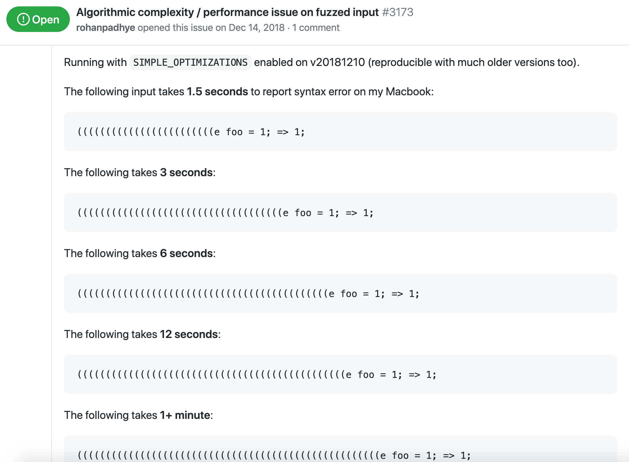
Closure Compiler: Super-Linear Runtime Bug

Slide 86
PerfFuzz
pick input
maximizing
# hits for
some edge
Input
Input
Initial
Input
Input
Input
mutate
Input
execute
Input
Input
Input_{n}’
save
Edge | # Hits
Maximizes # hits
for some edge?
Edge | # Hits
Edge | # Hits
Input₂’
Edge | # Hits
... | ...
... | ...
... | ...
... | ...
Input_{n}’

Slide 87
Observation: Algorithm is More General
pick input
maximizing
# hits for
some edge
Input
Input
Initial
Input
Input
Input
mutate
Input
execute
Input
Input
Input_{n}’
save
Edge | # Hits
Maximizes # hits
for some edge?
Edge | # Hits
Edge | # Hits
Input₂’
Edge | # Hits
... | ...
... | ...
... | ...
... | ...
Input_{n}’

Slide 88
Observation: Algorithm is More General
pick input
maximizing
value for
some key
Input
Input
Initial
Input
Input
Input
mutate
Input
execute
Input
Input
Input_{n}’
save
Key | Value
Maximizes value
for some key?
Key | Value
Key | Value
Input₂’
Key | Value
... | ...
... | ...
... | ...
... | ...
Input_{n}’

Slide 89
FuzzFactory
pick input
maximizing
value for
some key
Input
Input
Initial
Input
Input
Input
mutate
Input
execute
Input
Input
Input_{n}’
save
Key | Value
Maximizes value
for some key?
Key | Value
Key | Value
Input₂’
Key | Value
... | ...
... | ...
... | ...
... | ...
Input_{n}’

Slide 90
Case Study: Out-of-Memory Bugs
Key | Value
... | ...
... | ...
... | ...
... | ...
Memory Allocation Location:
Cumulative amount of memory allocated
Line 247:
x = malloc(…);

Slide 91
Maximizing Memory Allocations

Slide 92
Maximizing Memory Allocations

Slide 93
Maximizing Memory Allocations
Lots of “Hard” Comparisons
if ( f(x) == 0xBAD0CAFE)

Slide 94
Getting Through “Hard” Comparisons
Key | Value
... | ...
... | ...
... | ...
... | ...
“Hard” Comparison Location:
Number of bits matched
if ( f(x) == 0xBAD0CAFE)

Slide 95
Super Fuzzer: Hard Comparisons + Memory Allocations

Slide 96
Super Fuzzer: Hard Comparisons + Memory Allocations
LZ4 Bomb (4GB alloc when decoding 21-byte input)
PNG Bomb (2GB alloc when reading ~100 byte 20px image)

Slide 97
FuzzFactory: Abstraction Captures CGF
pick input
maximizing
value for
some key
Input
Input
Initial
Input
Input
Input
mutate
Input
execute
Input
Input
Input_{n}’
save
Key | Value
Maximizes value
for some key?
Key | Value
Key | Value
Input₂’
Key | Value
... | ...
... | ...
... | ...
... | ...
Input_{n}’

Slide 98
FuzzFactory: Abstraction Captures CGF
pick input
with new
aggregate
value for
some key
Input
Input
Initial
Input
Input
Input
mutate
Input
execute
Input
Input
Input_{n}’
save
Key | Value
New aggregate value
for some key?
Key | Value
Key | Value
Input₂’
Key | Value
... | ...
... | ...
... | ...
... | ...
Input_{n}’

Slide 99

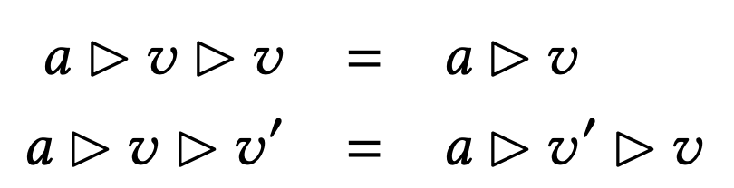
FuzzFactory: Abstraction Captures CGF
Given aggregator function
Satisfying
The aggregation process is monotonic (fuzzing makes progress). See Theorem 1.
pick input
with new
aggregate
value for
some key
Input
Input
Initial
Input
Input
Input
mutate
Input
execute
Input
Input
Input_{n}’
save
Key | Value
New aggregate value
for some key?
Key | Value
Key | Value
Input₂’
Key | Value
... | ...
... | ...
... | ...
... | ...
Input_{n}’

Slide 100
Background on Fuzzing
PerfFuzz
Lemieux, Padhye, Sen & Song. ISSTA ‘18
ACM/SIGSOFT Distinguished Paper Award
FuzzFactory
Padhye, Lemieux, Sen, Laurent & Vijayakumar. OOPSLA ‘19
Exploring Core Logic
Smart Generators
Future Directions

Slide 101

Background on Fuzzing
PerfFuzz
Lemieux, Padhye, Sen & Song. ISSTA ‘18
ACM/SIGSOFT Distinguished Paper Award
FuzzFactory
Padhye, Lemieux, Sen, Laurent & Vijayakumar. OOPSLA ‘19
Generalize “feedback” with map-based abstraction → new bug domains
Exploring Core Logic
Input
Input
Input
Input
Input
pick
mutate
Input
execute
Input
Input
Input_{n}’
Smart Generators
save
Execution Feedback
Execution Feedback
Input₂’
Interesting Feedback?
Execution Feedback
Input_{n}’
Execution Feedback_{n}
Future Directions

Slide 102
Background on Fuzzing
Performance Bugs
Exploring Core Logic
Smart Generators
Future Directions

Slide 103
Background on Fuzzing
Performance Bugs
Exploring Core Logic
Smart Generators
Future Directions

Slide 104
Background on Fuzzing
Performance Bugs
FairFuzz
Lemieux & Sen. ASE ‘18
ACM/SIGSOFT Distinguished Artifact Award,
Tool Demonstration Award
Zest
Padhye, Lemieux, Sen, Papadakis & Le Traon. ISSTA ‘19
Smart Generators
Future Directions

Slide 105
Where Are the Fuzzer-Found Bugs?
Input Validation
Core Logic

Slide 106
Where Are the Fuzzer-Found Bugs?
Input Validation
Core Logic

Slide 107
Problem: Random Mutations Ruin Structure
Input
Input
Initial
Input
Input
Input
pick
mutate
Input
execute
Input
Input
Input_{n}’
save
Execution Feedback
Execution Feedback
Input₂’
Interesting Feedback?
Execution Feedback
Input_{n}’
Execution Feedback_{n}

Slide 108
Problem: Random Mutations Ruin Structure
Input
Input
Initial
Input
Input
Input
pick
mutate
Input
execute
Input
Input
Input_{n}’
save
Execution Feedback
Execution Feedback
Input₂’
Interesting Feedback?
Execution Feedback
Input_{n}’
Execution Feedback_{n}

Slide 109
Problem: Random Mutations Ruin Structure
Input
Input
Initial
Input
Input
Input
pick
mutate
Input
execute
Input
Input
Input_{n}’
<foo>ez</foo>
mutate
<foo>ezzzfoo>
save
<floo>ez</foo>
<foo>>>>foo>
Execution Feedback
Execution Feedback
Input₂’
Interesting Feedback?
Execution Feedback
Input_{n}’
Execution Feedback_{n}

Slide 110
How to Retain Important Structure?
Input
Input
Initial
Input
Input
Input
pick
mutate
Input
execute
Input
Input
Input_{n}’
<foo>ez</foo>
mutate
<foo>ezzzfoo>
save
<floo>ez</foo>
<foo>>>>foo>
Execution Feedback
Execution Feedback
Input₂’
Interesting Feedback?
Execution Feedback
Input_{n}’
Execution Feedback_{n}

Slide 111
FairFuzz: Branch Mask Idea

Slide 112
FairFuzz: Branch Mask Idea
...
if (tags_match(fuzz_input)):
...

Slide 113
FairFuzz: Branch Mask Idea
...
if (tags_match(fuzz_input)):
...
True branch is rare

Slide 114
FairFuzz: Branch Mask Idea
...
if (tags_match(fuzz_input)):
...
True branch is rare
<foo>ez</foo>

Slide 115
FairFuzz: Branch Mask Idea
...
if (tags_match(fuzz_input)):
...
True branch is rare
hits rare branch
<foo>ez</foo>

Slide 116
FairFuzz: Branch Mask Idea
...
if (tags_match(fuzz_input)):
...
<foo>ez</foo>
Where can we mutate and still hit rare branch?

Slide 117
FairFuzz: Branch Mask Idea
...
if (tags_match(fuzz_input)):
...
<foo>ez</foo>
Where can we mutate and still hit rare branch?

Slide 118
FairFuzz: Branch Mask Idea
...
if (tags_match(fuzz_input)):
...
✓
mutate with
branch mask
<foo>eaz</foo>
<foo>ez</foo>
<foo>e</foo>
<foo><e/></foo>

Slide 119
FairFuzz: Branch Mask Computation
...
if (tags_match(fuzz_input)):
...
<foo>ez</foo>

Slide 120
FairFuzz: Branch Mask Computation
...
if (tags_match(fuzz_input)):
...
<foo>ez</foo>

Slide 121
FairFuzz: Branch Mask Computation
...
if (tags_match(fuzz_input)):
...
✗
?foo>ez</foo>
<foo>ez</foo>

Slide 122
FairFuzz: Branch Mask Computation
...
if (tags_match(fuzz_input)):
...
✗
✗
?foo>ez</foo>
<foo>ez</foo>

Slide 123
FairFuzz: Branch Mask Computation
...
if (tags_match(fuzz_input)):
...
✗
✗
?foo>ez</foo>
<?oo>ez</foo>
<foo>ez</foo>

Slide 124
FairFuzz: Branch Mask Computation
...
if (tags_match(fuzz_input)):
...
✗
✗
?foo>ez</foo>
✗
<?oo>ez</foo>
<foo>ez</foo>

Slide 125
FairFuzz: Branch Mask Computation
...
if (tags_match(fuzz_input)):
...
✗
?foo>ez</foo>
✗
<?oo>ez</foo>
<foo>ez</foo>
...

Slide 126
FairFuzz: Branch Mask Computation
...
if (tags_match(fuzz_input)):
...
✓
✗
?foo>ez</foo>
✗
<?oo>ez</foo>
<foo>ez</foo>
...
<foo>?z</foo>

Slide 127
FairFuzz: Branch Mask Computation
...
if (tags_match(fuzz_input)):
...
✓
✗
?foo>ez</foo>
✗
<?oo>ez</foo>
<foo>ez</foo>
✓
...
<foo>?z</foo>

Slide 128
FairFuzz: Branch Mask Computation
...
if (tags_match(fuzz_input)):
...
✓
✗
?foo>ez</foo>
✗
<?oo>ez</foo>
<foo>ez</foo>
✓
...
<foo>?z</foo>
<foo>e?</foo>

Slide 129
FairFuzz: Branch Mask Computation
...
if (tags_match(fuzz_input)):
...
✓
✗
?foo>ez</foo>
✗
<?oo>ez</foo>
<foo>ez</foo>
✓
...
<foo>?z</foo>
<foo>e?</foo>
✓

Slide 130
FairFuzz: Branch Mask Computation
...
if (tags_match(fuzz_input)):
...
✗
?foo>ez</foo>
✗
<?oo>ez</foo>
<foo>ez</foo>
✓
...
<foo>?z</foo>
<foo>e?</foo>
✓
...

Slide 131
FairFuzz: Branch Mask Computation
...
if (tags_match(fuzz_input)):
...
✗
?foo>ez</foo>
✗
<?oo>ez</foo>
<foo>ez</foo>
✓
...
<foo>?z</foo>
<foo>e?</foo>
✓
...
summarize in branch mask
<foo>ez</foo>

Slide 132
FairFuzz
seeds
Input
Input
Initial
Input
Input
Input
pick
mutate
Input
execute
Input
Input
Input_{n}’
save
Execution Feedback
Execution Feedback
Input₂’
Interesting Feedback?
Execution Feedback
Input_{n}’
Execution Feedback_{n}

Slide 133
FairFuzz
seeds
pick input
hitting rare branch
Input
Input
Initial
Input
Input
Input
mutate
Input
execute
Input
Input
Input_{n}’
save
Execution Feedback
Execution Feedback
Input₂’
Interesting Feedback?
Execution Feedback
Input_{n}’
Execution Feedback_{n}

Slide 134
FairFuzz
seeds
pick input
hitting rare branch
compute +
mutate with
branch mask
Input
Input
Initial
Input
Input
Input
Input
execute
Input
Input
Input_{n}’
save
Execution Feedback
Execution Feedback
Input₂’
Interesting Feedback?
Execution Feedback
Input_{n}’
Execution Feedback_{n}

Slide 135
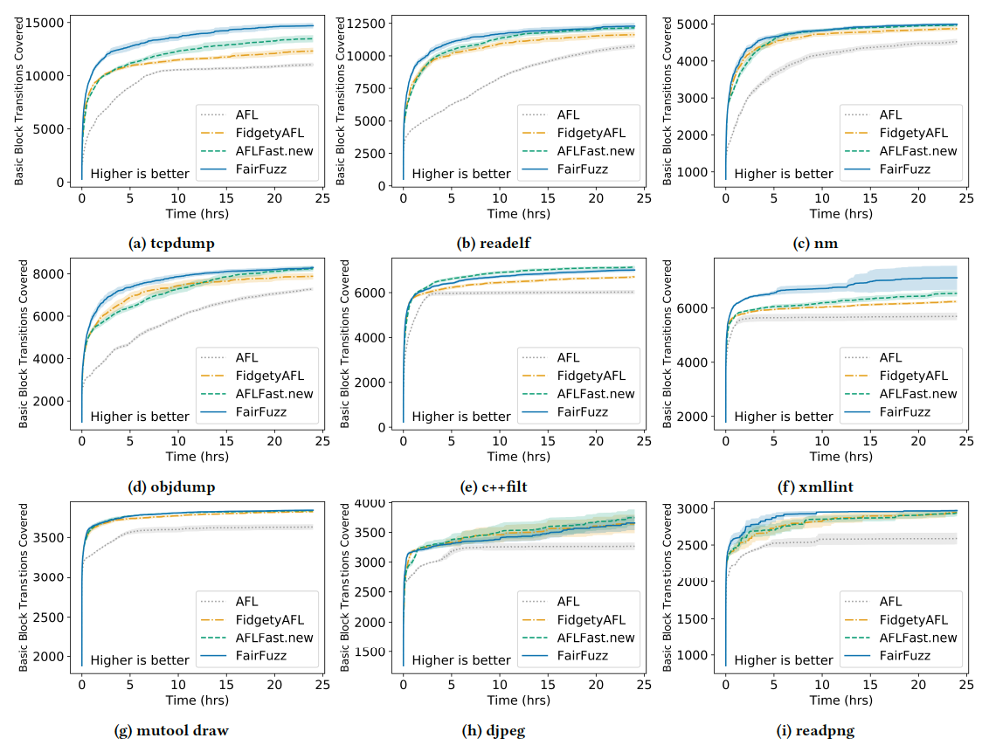
FairFuzz: Up to 10.6% Higher Branch Coverage

Slide 136
FairFuzz: Up to 10.6% Higher Branch Coverage

Slide 137

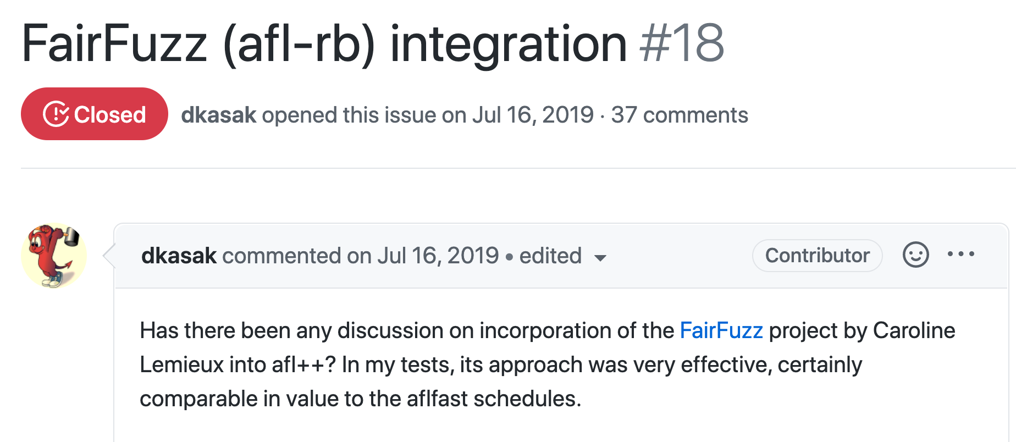
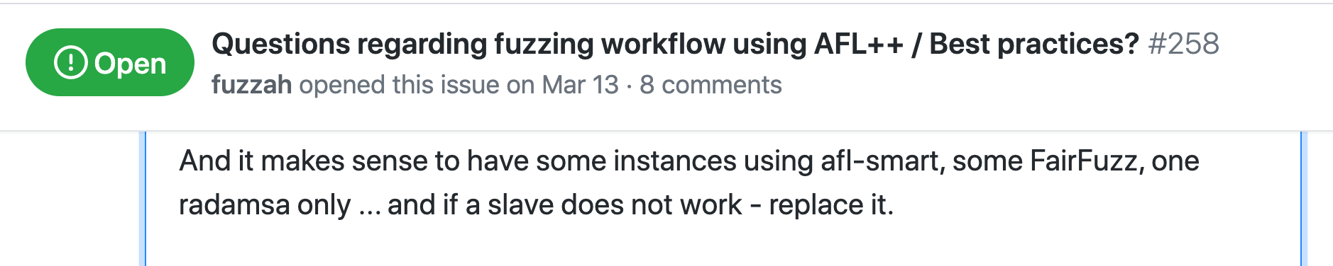
Continued Use in Fuzzing Community

Slide 138
Can we get higher-level mutations?
with more information about input structure?
Input
Input
Initial
Input
Input
Input
pick
mutate
Input
execute
Input
Input
Input_{n}’
save
Execution Feedback
Execution Feedback
Input₂’
Interesting Feedback?
Execution Feedback
Input_{n}’
Execution Feedback_{n}

Slide 139
Generators as Input Structure Specification
Input Generator
Input

Slide 140
How to Get Mutations?
def genXML(random):
tag = random.choice(tags)
node = XMLElement(tag)
num_child = random.nextInt(0, MAX_CHILDREN)
for i in range(0, num_child):
node.addChild(genXML(random))
if random.nextBoolean():
node.addText(random.nextString()) return node

Slide 141
Generator: Source of Randomness → Input
def genXML(random):
tag = random.choice(tags)
node = XMLElement(tag)
num_child = random.nextInt(0, MAX_CHILDREN)
for i in range(0, num_child):
node.addChild(genXML(random))
if random.nextBoolean():
node.addText(random.nextString()) return node
S
TR

Slide 142
Generator: Source of Randomness → Input
def genXML(random):
tag = random.choice(tags)
node = XMLElement(tag)
num_child = random.nextInt(0, MAX_CHILDREN)
for i in range(0, num_child):
node.addChild(genXML(random))
if random.nextBoolean():
node.addText(random.nextString()) return node
foo
S
TR
<foo>
</foo>

Slide 143
Generator: Source of Randomness → Input
def genXML(random):
tag = random.choice(tags)
node = XMLElement(tag)
num_child = random.nextInt(0, MAX_CHILDREN)
for i in range(0, num_child):
node.addChild(genXML(random))
if random.nextBoolean():
node.addText(random.nextString()) return node
foo
S
TR
<foo>
</foo>

Slide 144
Generator: Source of Randomness → Input
def genXML(random):
tag = random.choice(tags)
node = XMLElement(tag)
num_child = random.nextInt(0, MAX_CHILDREN)
for i in range(0, num_child):
node.addChild(genXML(random))
if random.nextBoolean():
node.addText(random.nextString()) return node
foo
S
TR
<foo>
</foo>

Slide 145
Generator: Source of Randomness → Input
def genXML(random):
tag = random.choice(tags)
node = XMLElement(tag)
num_child = random.nextInt(0, MAX_CHILDREN)
for i in range(0, num_child):
node.addChild(genXML(random))
if random.nextBoolean():
node.addText(random.nextString()) return node
foo
bar
S
TR
<foo>
<bar/>
</foo>

Slide 146
Generator: Source of Randomness → Input
def genXML(random):
tag = random.choice(tags)
node = XMLElement(tag)
num_child = random.nextInt(0, MAX_CHILDREN)
for i in range(0, num_child):
node.addChild(genXML(random))
if random.nextBoolean():
node.addText(random.nextString()) return node
foo
bar
baz
Text{”xyz”}
S
TR
<foo>
<bar/>
<baz>“xyz”</baz> </foo>

Slide 147
Generator: Source of Randomness → Input
def genXML(random):
tag = random.choice(tags)
node = XMLElement(tag)
num_child = random.nextInt(0, MAX_CHILDREN)
for i in range(0, num_child):
node.addChild(genXML(random))
if random.nextBoolean():
node.addText(random.nextString()) return node
foo
bar
baz
Text{”xyz”}
S
TR
<foo>
<bar/>
<baz>“xyz”</baz> </foo>

Slide 148
Source of Randomness == Infinite Bit-Sequence
pseudo-random bits:
0000 0011 0110 0110 0110 1111 0110 1111 0000 0010 ...
def genXML(random):
tag = random.choice(tags)
node = XMLElement(tag)
num_child = random.nextInt(0, MAX_CHILDREN)
for i in range(0, num_child):
node.addChild(genXML(random)
if random.nextBoolean():
node.addText(random.nextString()) return node
foo
bar
baz
Text{”xyz”}
S
TR
<foo>
<bar/>
<baz>“xyz”</baz> </foo>

Slide 149
Bit Mutations → Structured Input Mutations
pseudo-random bits:
0000 0011 0110 0110 0110 1111 0110 1111 0000 0010 ...
def genXML(random):
tag = random.choice(tags)
node = XMLElement(tag)
num_child = random.nextInt(0, MAX_CHILDREN)
for i in range(0, num_child):
node.addChild(genXML(random)
if random.nextBoolean():
node.addText(random.nextString()) return node
foo
bar
baz
Text{”xyz”}
S
TR
<foo>
<bar/>
<baz>“xyz”</baz> </foo>

Slide 150
Bit Mutations → Structured Input Mutations
pseudo-random bits:
0000 0011 0101 0111 0110 1111 0110 1111 0000 0010 ...
def genXML(random):
tag = random.choice(tags)
node = XMLElement(tag)
num_child = random.nextInt(0, MAX_CHILDREN)
for i in range(0, num_child):
node.addChild(genXML(random))
if random.nextBoolean():
node.addText(random.nextString()) return node
woo
bar
baz
Text{”xyz”}
S
TR
<woo>
<bar/>
<baz>“xyz”</baz> </woo>

Slide 151
Zest: Integrate Generator + CGF
Params
Generator
seeds
Input
Input
Initial
Input
Input
Input
pick
mutate
Input
execute
Input
Input
Input_{n}’
save
Execution Feedback
Execution Feedback
Input₂’
Interesting Feedback?
Execution Feedback
Input_{n}’
Execution Feedback_{n}

Slide 152
Zest: Integrate Generator + CGF
seeds
Input
Input
execute
input
Initial
Input
Input
Input
pick
mutate
Input
Generator
Params
Params
Params_{n}’
save
Execution Feedback
Execution Feedback
Input₂’
Interesting Feedback?
Execution Feedback
Params_{n}’
Execution Feedback_{n}

Slide 153
Zest: Integrate Generator + CGF
seeds
Higher-level mutations via generator
Input
Input
execute
input
Initial
Input
Input
Input
pick
mutate
Input
Generator
Params
Params
Params_{n}’
save
Execution Feedback
Execution Feedback
Input₂’
Interesting Feedback?
Execution Feedback
Params_{n}’
Execution Feedback_{n}

Slide 154
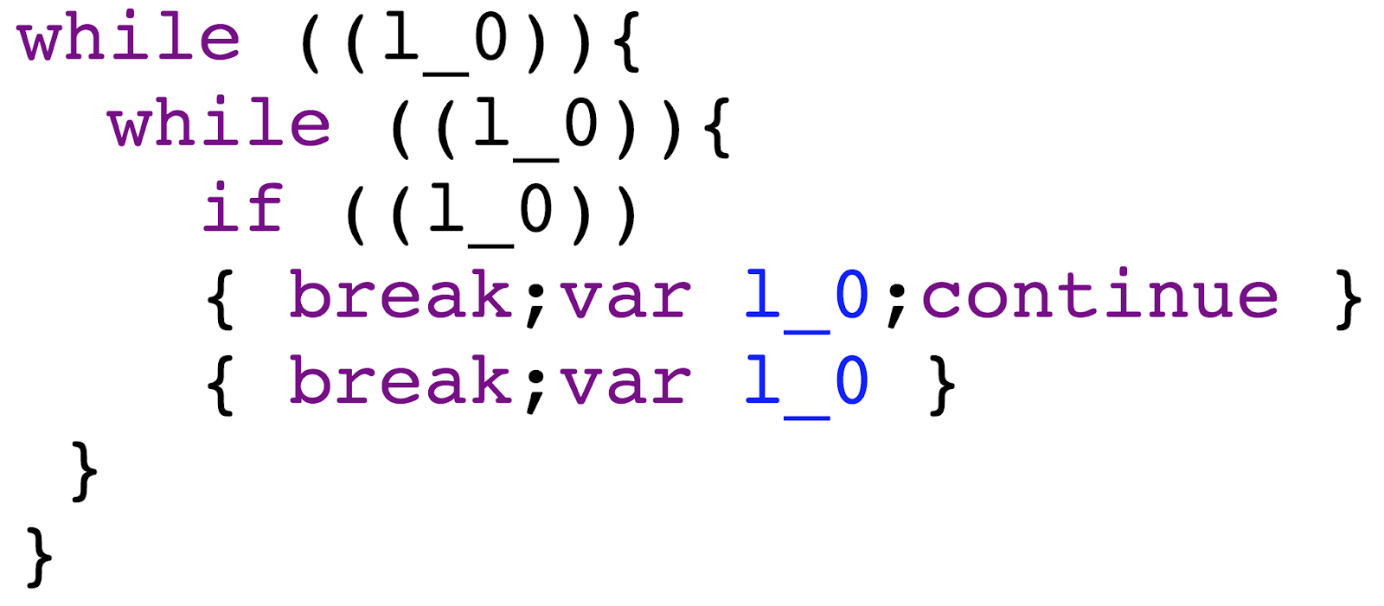

Zest finds complex semantic bugs
Closure Logo CC-by-SA 4.0: https ://en.wikipedia.org/wiki/File:Closure_logo.svg
Google Closure Compiler
Zest-generated JavaScript input
Unreachable statement…
but not dead code!
IllegalStateException in VarCheck during optimization

Slide 155
Background on Fuzzing
Performance Bugs
FairFuzz
Lemieux & Sen. ASE ‘18
ACM/SIGSOFT Distinguished Artifact Award,
Tool Demonstration Award
Zest
Padhye, Lemieux, Sen, Papadakis & Le Traon. ISSTA ‘19
Smart Generators
Future Directions

Slide 156
Background on Fuzzing
Performance Bugs
FairFuzz
Lemieux & Sen. ASE ‘18
ACM/SIGSOFT Distinguished Artifact Award,
Tool Demonstration Award
Zest
Padhye, Lemieux, Sen, Papadakis & Le Traon. ISSTA ‘19
Structure-aware mutations
→ New depth of program exploration
Input
Smart Generators
Input
mutate
Input
Input
Input_{n}’
Future Directions

Slide 157
Background on Fuzzing
Performance Bugs
Exploring Core Logic
Smart Generators
Future Directions

Slide 158
Background on Fuzzing
Performance Bugs
Exploring Core Logic
Smart Generators
Future Directions

Slide 159
Background on Fuzzing
Performance Bugs
Exploring Core Logic
RLCheck
Reddy, Lemieux, Padhye & Sen. ICSE ‘20.
RLCheck
AutoPandas
Bavishi, Lemieux, Sen & Stoica. OOPSLA ‘19
Future Directions

Slide 160
Separate distribution from user-facing generator → faster fuzzing, new synthesis paradigm
Background on Fuzzing
Guidance
Generator
Performance Bugs
Execution Feedback
Exploring Core Logic
RLCheck
Reddy, Lemieux, Padhye & Sen. ICSE ‘20.
RLCheck
AutoPandas
Bavishi, Lemieux, Sen & Stoica. OOPSLA ‘19
Future Directions

Slide 161
Background on Fuzzing
Performance Bugs
Exploring Core Logic
Smart Generators
Future Directions

Slide 162
Background on Fuzzing
Performance Bugs
Exploring Core Logic
Smart Generators
Future Directions

Slide 163
So Far: Innovations in Fuzz Testing
Test-Input Generation

Slide 164
Problems Around Fuzzing
Fuzzing
How do I write a good test driver?

Slide 165
Problems Around Fuzzing
Fuzzing
How do I write a good test driver?
How do I specify the structure
of my inputs?

Slide 166
Problems Around Fuzzing
Fuzzing
How do I write a good test driver?
How do I specify the structure
of my inputs?
Do I really care about this bug?

Slide 167
Solving Problems Around Fuzzing
Fuzzing

Slide 168
Solving Problems Around Fuzzing
Fuzzing

Slide 169
Automating Fuzzing “Infrastructure”
Leveraging Easy Human Insights
Fuzzing
Understanding Fuzzing Formally

Slide 170
Automating Fuzzing “Infrastructure”
Leveraging Easy Human Insights
Fuzzing
Example Projects:
Fuzz driver synthesis
Grammar synthesis
Data-structure generator synthesis
Automated bug patching
Understanding Fuzzing Formally

Slide 171
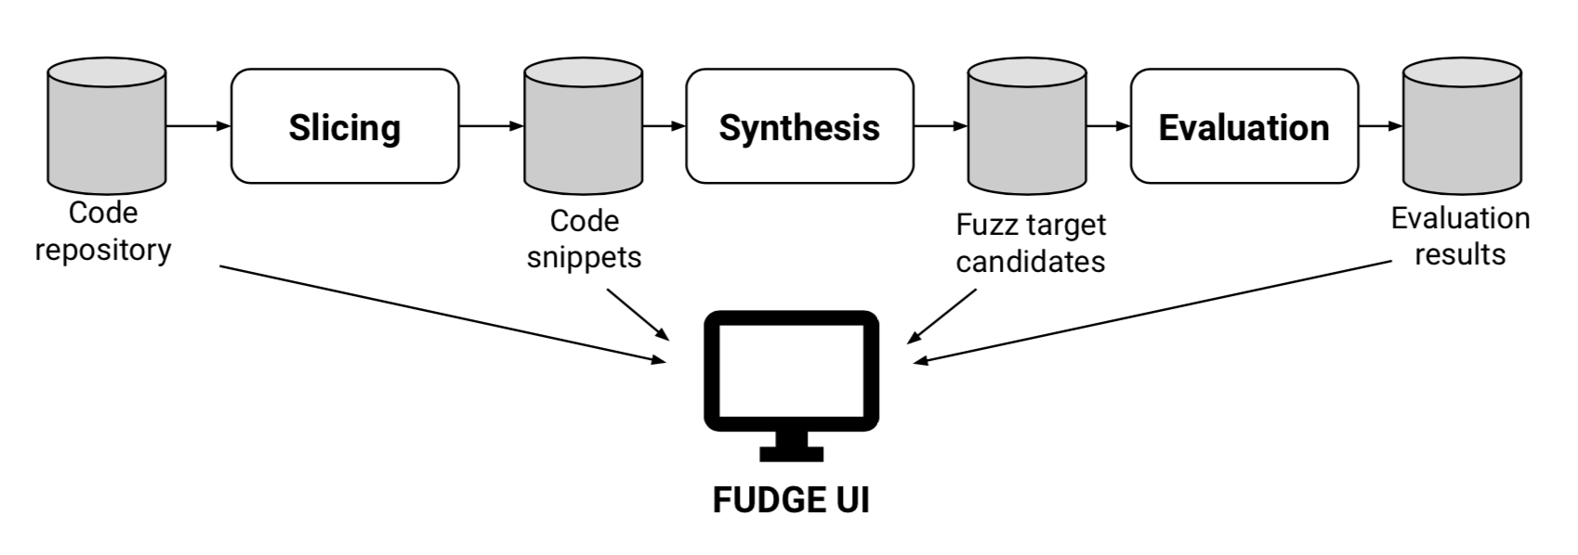
Automating Fuzzing “Infrastructure”
Leveraging Easy Human Insights
Fuzzing
FUDGE
Babic, Bucur, Chen, Ivancic, King,
Kusano, Lemieux, Szekeres, Wang
ESEC/FSE’19 (Industry Track)
Example Projects:
Fuzz driver synthesis
Grammar synthesis
Data-structure generator synthesis
Automated bug patching
Best Paper Award
(Industry Track)
Understanding Fuzzing Formally
200 drivers integrated into open-source projects
→150 security-improving fixes

Slide 172
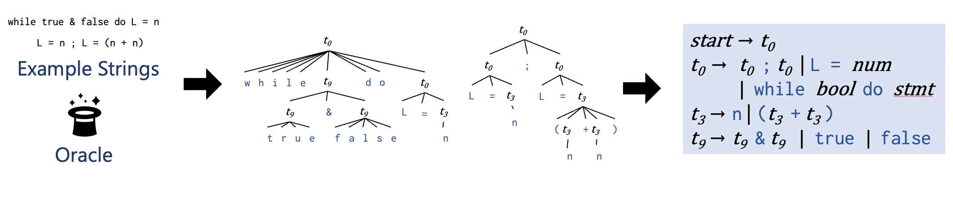
Automating Fuzzing “Infrastructure”
Leveraging Easy Human Insights
Fuzzing
Arvada
Kulkarni*, Lemieux*, Sen
ASE’21
Example Projects:
Fuzz driver synthesis
Grammar synthesis
Data-structure generator synthesis
Automated bug patching
Understanding Fuzzing Formally
5x higher recall that state-of-the-art ☺
1.27x slowdown ☹

Slide 173
Automating Fuzzing “Infrastructure”
Leveraging Easy Human Insights
Fuzzing
Example Projects:
Fuzz driver synthesis
Grammar synthesis
Data-structure generator synthesis
Automated bug patching
Understanding Fuzzing Formally

Slide 174
Automating Fuzzing “Infrastructure”
Leveraging Easy Human Insights
Fuzzing
Understanding Fuzzing Formally

Slide 175
Leveraging Easy Human Insights
Automating Fuzzing “Infrastructure”
Fuzzing
Example Projects:
UI for user-directed fuzzing
Human feedback to tune generator search space
Assisted test-oracle synthesis
Understanding Fuzzing Formally

Slide 176
Automating Fuzzing “Infrastructure”
Leveraging Easy Human Insights
Fuzzing
Understanding Fuzzing Formally

Slide 177
Example Projects:
How does mutation size affect coverage and bug finding?
What are the limitations of any fuzzing tool? (How do I choose which fuzzing tool to use?)
Automating Fuzzing “Infrastructure”
Leveraging Easy Human Insights
Fuzzing
Understanding Fuzzing Formally

Slide 178
Open Problems Around Fuzzing
Example Projects:
UI for user-directed fuzzing
Human feedback to tune generator search space
Assisted test-oracle synthesis
Example Projects:
Fuzz driver synthesis
Grammar synthesis
Data-structure generator synthesis
Automated bug patching
Automating Fuzzing “Infrastructure”
Leveraging Easy Human Insights
Fuzzing
Example Projects:
What are the limitations of any fuzzing tool? (How do I choose which fuzzing tool to use?)
How does mutation size affect coverage and bug finding?
Understanding Fuzzing Formally

Slide 179

Generalize “feedback” with map-based abstraction → new bug domains
Input
Input
Input
Input
Input
pick
mutate
Input
execute
Input
Input
Input_{n}’
save
Execution Feedback
Execution Feedback
Input₂’
Interesting Feedback?
Execution Feedback
Input_{n}’
Execution Feedback_{n}
Structure-aware mutations
New depth of program exploration
Automating Fuzzing “Infrastructure”
Leveraging Easy Human Insights
Input
Fuzzing
Input
Input
mutate
Input
Input_{n}’
Separate distribution from user-facing generator → faster fuzzing, new synthesis paradigm
Understanding Fuzzing Formally
Guidance
Generator
Execution Feedback

